Slide 1

Introduction – BSBPEF301
Organise Personal Work Priorities

Slide 2
In this topic we will cover:
Organise and complete own work schedule
Evaluate own work performance
Co-ordinate personal skill development and learning

Slide 3
Unit 1 – Organise and complete own work schedule
Setting SMART goals for yourself and for your business!
Specific
Define as clearly as possible
Ask yourself: Why this goal?
Measurable
How are you going to measure your achievements?
How do you know you are on the right track?
Achievable
Do you have what you need to achieve the goal?
Can you get what you need to achieve the goal?
Realistic
Time bound
Is the goal realistically achievable?
When do you want or need to have achieved it by?
Do you need to adjust or revise the goal?
Why did you pick that date?

Slide 4

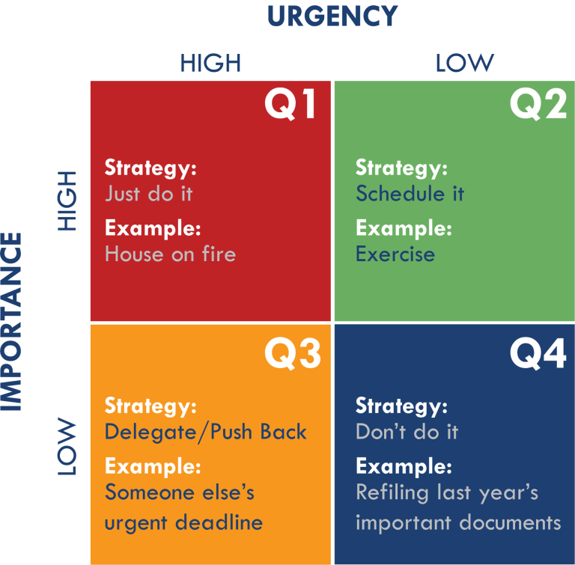
Unit 1 – Organise and complete own work schedule
Eisenhower Matrix
Recognising priorities (Know what is important to you and your business!)
Is it important? Is it urgent?
Will doing this task take you closer to or further away from your goal?
What will it cost (in time and money) if you do the task, versus delegating the task?
Q3

Slide 5



– What are the goals for yourself and the business?
Let’s Discuss…
Goals for yourself (Life goals)
Goals for the business (Business goals)
Do they complement one another, or do they conflict?

Slide 6
Unit 1 – Organise and complete own work schedule
Projects (Goals)
Tasks (To Do)
Cannot be completed in a few hours
Require multiple tasks to be completed
In a certain order and sequence
Using multiple resources
With a set or estimated deadline
Can be completed in less than a few hours.
Immediate outcome / achievement
Independent or interdependent (part of a project)
Can have high or low priority
Using few resources
Deadline depends on interdependency

Slide 7
Unit 1 – Organise and complete own work schedule
A project or goal can have multiple objectives, these objectives can be reached by completing certain tasks. Example: Moving house is a project. To move house, we need to achieve the following objectives:
Organise a new house
Organise transport / removalists
Organise packing and cleaning of previous house
Organising a new house can be broken down into tasks:
Discuss with partner the location
Determine available finances
Contact real estate agents
View houses / select house
Complete contract / receive key
Project
Objectives 1
Task
Objective 2
Objective 3
Task
Task
Task
Task
Task

Slide 8


– What are the objectives planned to achieve these goals?
Let’s Discuss…
What are you going to do to achieve these goals?
What KPI’s (Key Performance Indicators) can you put in place to measure your performance (over a specific period of time) and if you are achieving the desired outcomes?
Tip: Remember SMART – Goals!
Q2

Slide 9
Unit 1 – Organise and complete own work schedule
Relaxation & Fun
Running the business & Earning money
Go to a party Friday night
Stay in bed until 09:00 AM
30th of June Birthday Party
Watch Netflix
Play Fortnight Game
Go to dinner with friends
Go on a holiday
Complete the invoicing Friday night
Client appointment at 07:30 AM
30th of June Stock take
Research new government laws
Improve your marketing
Go to networking event
Earn money for a holiday

Slide 10
Unit 2 – Evaluate own work performance
Setting SMART goals and measuring (celebrating) achievements
Key performance Indicators – Measuring what is key (must achieve) either by contract, by law/regulation or by the bottom-line.
Measuring your time – How long does it really take you to perform a task? Have you taken into account everything? (Billable and non-billable hours of time.)

Slide 11
– Explain the principles and techniques for the following:
Let’s Discuss…
Goal setting
Measuring performance
Time management

Slide 12
– Explain signs and sources of stress and strategies to deal with stress in your business.
Let’s Discuss…
Signs of stress
Sources of stress
Strategies to deal with stress

Slide 13
Unit 3 – Co-ordinate personal skill development and learning
Performing a knowledge and skill assessment https://www.skillsroad.com.au/
Performing a personality test
https://www.16personalities.com/free-personality-test
Identify the skills required in your business (contents of this course)
Identifying ongoing professional development required (Upskilling with new technology, renewal of certification, industry requirements etc.)

Slide 14
– Complete an assessment of your own personal learning and development needs and how you would plan to prioritise and undertake relevant education and skills development.
Let’s Discuss…
What are you good at?
What needs improvement?
How are you going to plan your learning?
Negotiation skills
Time management skills
Communication skills
Financial management skills
Technology skills
Public speaking skills
Sales & marketing skills
Knowledge of tax
Knowledge of laws
Knowledge of industry
Knowledge of competitors
Knowledge of customers (wants & needs)
Knowledge of managing a team
Knowledge of resources

Slide 15
To Do List
Complete and submit the Introductory Topic Quiz
Ensure you passed the Quiz 100% (You have unlimited attempts.)
Complete the tasks in the Introductory Assignment
  Download the 4 documents you will need throughout the course
  Plan your Study time! All 4 documents are due in week 4!
  Plan what else you will need for your business!
    ABN number (and possible business name registration.) REQUIRED
    Insurance (Minimum 5 million $ Public Liability Insurance) REQUIRED ALL BUSINESSES
    Council permission (if your council requires it.)
    Landlord permission (if applicable.)
    Licenses and Permits (if applicable.)
Remember these things take time to organise! Plan accordingly!

