Slide 1

Topic Nine – BSBESB404
Market New Business Ventures

Slide 2
In this topic we will cover:
Develop marketing strategies for business venture
Establish marketing mix for the business venture
Implement marketing strategies
Evaluate marketing performance
Please download and open your Marketing Plan Template from Canvas!

Slide 3
Unit 1 – Develop marketing strategies for business venture
How are you going to develop marketing strategies?
What is your product or service?
Who is it for?
Who is your marketing persona?
Where can you find them?
How would they behave?
How much could they spend?
What is important to them in your product or service?

Slide 4
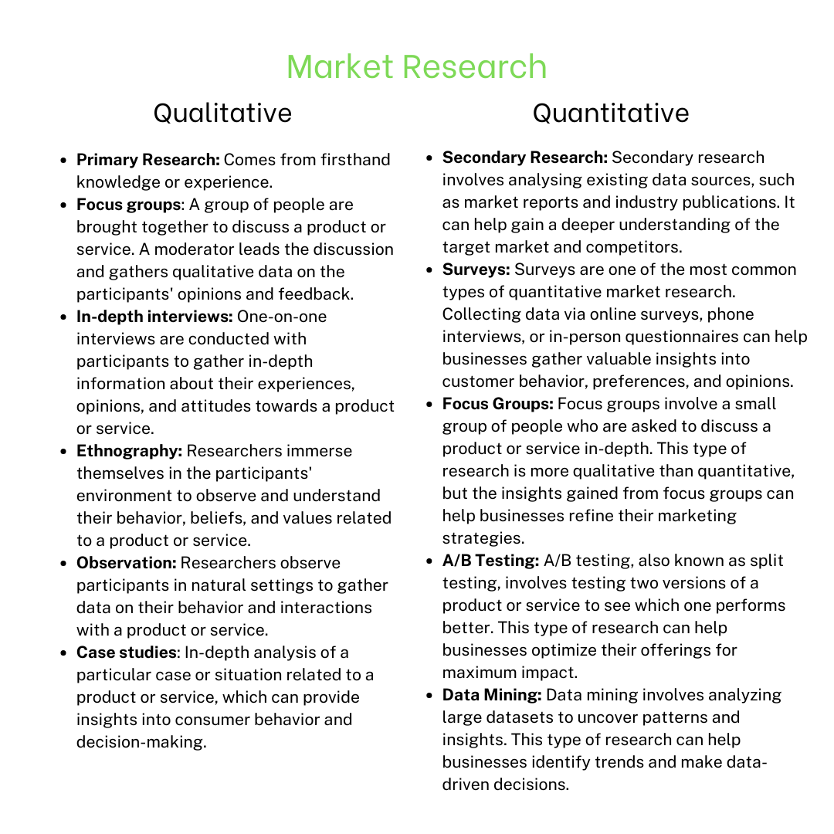
Unit 1 – Develop marketing strategies for business venture
Starting with market research
Before you invest a lot of time, effort and money into starting your business, you need to find out:
If there is a good market for it
How large that market is
How much your target market is willing or able to spend
What your target market likes and dislikes
How your target market behaves
What they think could be improved in your product or service (idea)

Slide 5

Creating a User or Marketing Persona

Slide 6

Digital Marketing in 2023
5 Explosive Digital Marketing Strategies for 2023 (BIG Changes Ahead!) - YouTube

Slide 7



Business Plan Activity (Persona)– Who/what is your specific target market (ie: potential clients or customers who are your key focus)?
Let’s Discuss…
Consider age, identified gender, marital status, financial position, location etc.
How do you plan to connect to them (ie: what's your marketing strategy)
Not everyone wants your product or service and that is okay! You need to focus your marketing efforts on those who DO (desperately) want your product or service! They are most likely to buy!!!
With a small marketing budget, you have to be selective, where you spend your money in marketing and advertising! If you are only operating in the Perth Metro Area, don’t spend your advertising budget on Western Australia, but only on the suburbs you actually need to reach.

Slide 8

Business Plan Activity (SMART Goals)– Define your SMART Goals when marketing! Specific, Measurable, Attainable, Realistic, Timely.
Let’s Discuss…
How can you be specific and define exactly who will want your product?
How are you going to measure you have reached the goal? (Number of customers, number of sales?)
Is it attainable? If there are only 30 lawns to mow in your area, you cannot mow 30-40 lawns every week!
Can you realistically serve that many customers? Things always take more time, money and resources than expected!
In what time-frame do you need to achieve this? 3- months, 6-months, 12-months? Not setting a time, will not allow you to measure progress.
Q1

Slide 9
Business Plan Activity (Persona)– Who/what is your specific target market (ie: potential clients or customers who are your key focus)?
Let’s Discuss…
You are thinking about buying a new phone. You browses the web or were chatting to a friend about what phone to get. Suddenly Facebook shows you phones you might be interested in! How did they know you were looking for a new phone??
Digital Marketing! Facebook monitors everything you do: Your interests, where you are, what you like or love, your education level, the friends you have, what you search for, the causes you support and it creates a “Customer Persona” in it’s database. If you like food, it will show you more of that, if you like funny pets, it will show you more pet videos!

Slide 10

Digital Marketing Tools
Keeping track of your leads and customers!

Slide 11
Business Plan Activity– Based on your analysis to date with digital technologies, market research and customer needs:
Let’s Discuss…
What are you planning for promotional activities?
How do you plan to maintain engagement with your clients?
How will you monitor and evaluate marketing and promotional activities and performance?
How will you aim to correct any performance gaps ie: not achieving your initial plans?
Please consider that this information will be useful to add to you Marketing Action Plan outlined and attached in the Project below.

Slide 12





How are you going to establish a competitive advantage over your competitors?
Let’s Discuss…
Consider opportunities for disruption, niche markets, specialised services, new skills, new products, ancillary services, pricing, economies of scale etc.
Be a “Purple Cow”! Stand out from the crowd by daring to do things differently.
(Purple Cow is also a term invented by best-selling marketing author:
Seth Godin.)

Slide 13
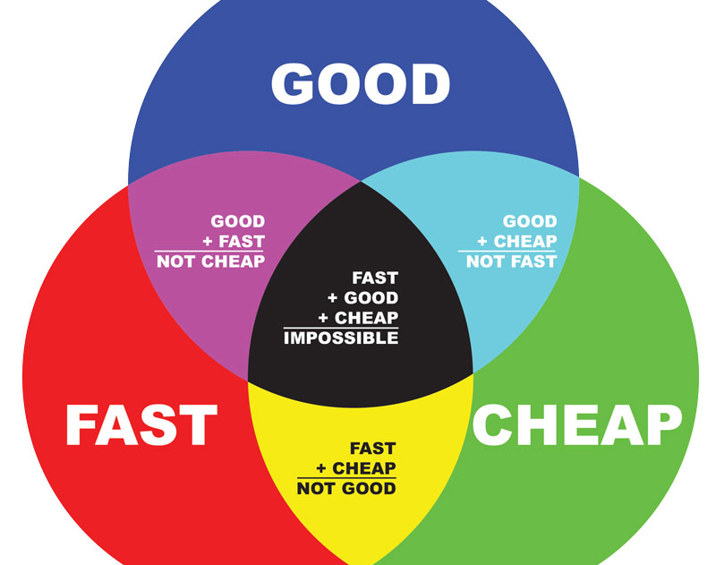
Competitor Advantage
It is all about the balance between:
Quality
Price
Speed
Are your competitors:
Cheap and Fast, but not good?
Good and Fast, but not cheap?
Good and Cheap, but not fast?

Slide 14
How are you going to implement these marketing strategies?
Do it yourself?
Hiring staff or freelancers?
Do you have the time, money and knowledge to do this (all) yourself?
Would it be cost-effective to do it yourself?
How do you calculate that?
Who do you need to hire?
Have you defined exactly what you need?
What would it cost to hire a freelancer?
What are the hidden costs?

Slide 15
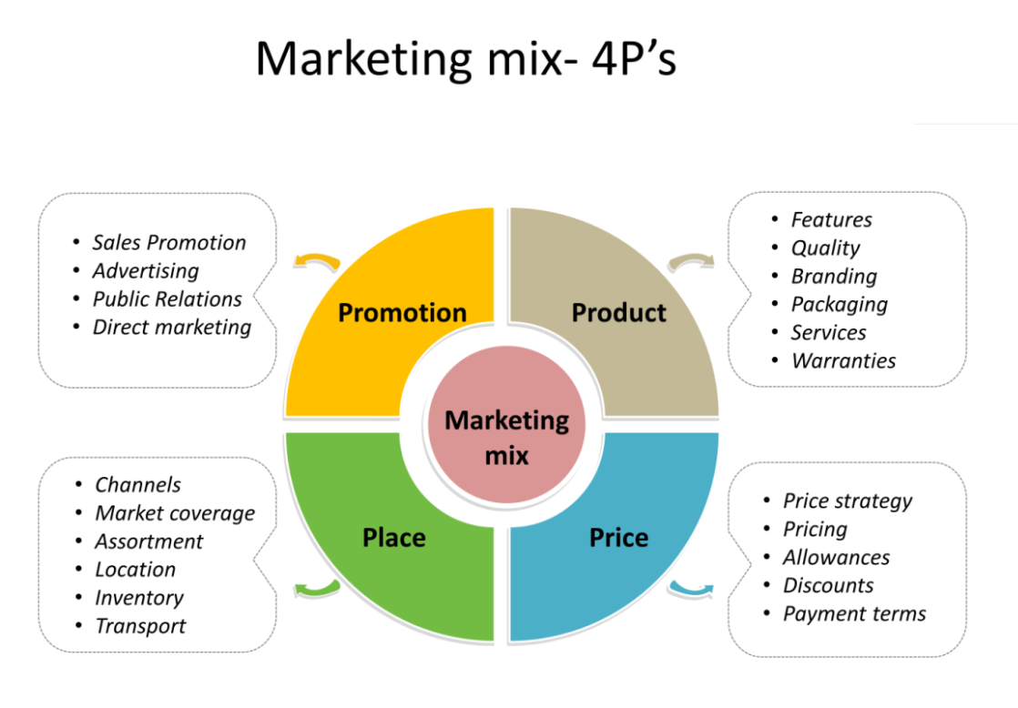
Unit 2 – Establish marketing mix for the business venture
What is a marketing mix?
Definition: The marketing mix refers to the set of actions, or tactics, that a company uses to promote its brand or product in the market.
The 4Ps make up a typical marketing mix - Price, Product, Promotion and Place. ... Pricing can also be used a demarcation, to differentiate and enhance the image of a product.

Slide 16

Unit 4 – Evaluate marketing performance
How to keep track of the performance of your marketing strategy?
Goals – Objectives – Tasks
Measuring the essentials (ROI)
Measuring the performance (KPI)

Slide 17
– How do you plan to manage or monitor the following areas of the business?
Let’s Discuss…
Analysing costs and benefits of marketing strategies (How much did your marketing cost? How much did you earn? Did the cost of marketing justify the income?)
Monitoring customer satisfaction (How do you measure customer satisfaction?)
Conducting market analysis and ongoing research (How many customers are there in your area who are willing to buy your product or service at the price you need to charge?)

Slide 18
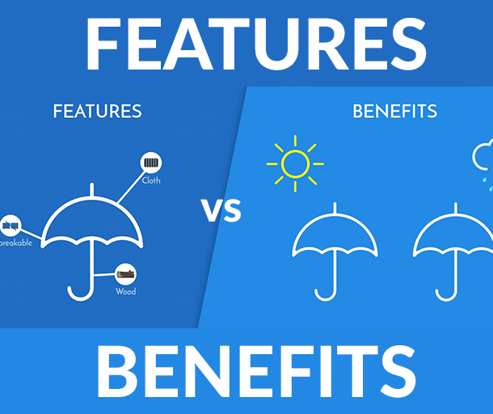
Features and Benefits
Features are the actual characteristics and capabilities of your product.
Benefits are how these features provide value to your customers. For example, a digital camera’s features might include megapixels, lens type, and memory card size, but its benefit would be the ability to capture action shots without motion blur.
Analyse your offerings to make sure you understand your features and benefits and can leverage both in marketing.
In most cases, people care more about the benefits than about the features and specifications (unless your customer “persona” is technically minded.)

Slide 19
– What are the features and benefits of your products and/or services?
Let’s Discuss…
What are some of the features of your product or service?
What are some of the benefits of your product or service?

Slide 20

Benefit Statement
From the information you gathered from the previous activity, craft a benefit statement for your product/service. Don’t forget to include the WHY, WHAT and HOW
Here’s an example:
WHY: We care about your memories because we at Picture Perfect Photography understand that memories are priceless.
WHAT: We capture and preserve your cherished family memories for generations to come.
HOW: We print on archival canvas so your portraits will stand the test of time and become cherished heirlooms.”
*CREATE YOUR OWN STATEMENT NOW*

Slide 21

Feedback (Measuring Customer Satisfaction)
How happy are your customers?
What do they like about your product or service?
What can be improved?
Will they keep buying from you or are they considering buying somewhere else and why?
How many returns or refunds did you get?
What was the reason?
How are you going to collect this information?
How are you going to keep track of this information?
What are you going to DO with the information?

Slide 22
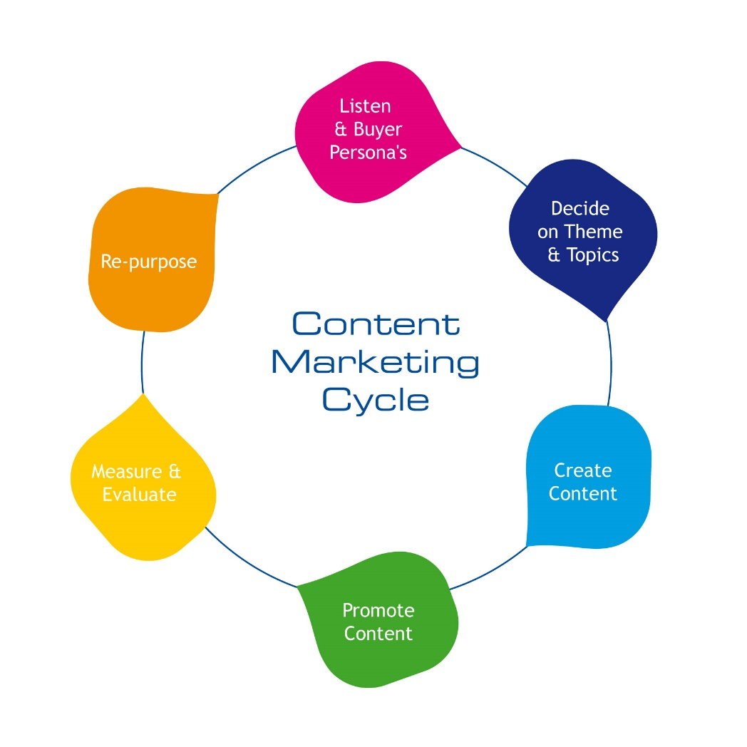
Marketing Cycle
Listen to the customer & buyer’s persona
Decide on a theme & topic
Create content
Promote content
Measure & evaluate
Re-purpose content

Slide 23
– Explain the methods you will use to gather verifiable customer feedback about your products and/or services?
Let’s Discuss…
What is verifiable customer feedback?
How do you collect it?

Slide 24
To Do List
Update your Marketing Plan
Update your Business plan
Complete Topic 9 Quiz

