Slide 1

Topic Seven – BSBFIN302
Maintain Financial Records

Slide 2
In this topic we will cover:
Prepare journals required for posting general ledger
Post journal entries and reconcile discrepancies
Maintain general ledger

Slide 3
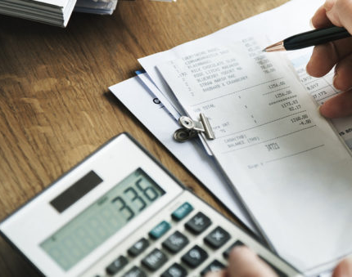
Unit 1 – Prepare journals required for posting general ledger
What does ‘Bookkeeping’ mean?
Develop or use a system (Excel, manual or accounting app)
Tracking income and expenses (money in and out, Debit and Credit)
Keeping receipts- 5 years for Tax purposes and digitising receipts. 7 years for staff records.
What does ‘Accounting’ mean?
Calculating Goods and Services Tax (GST)
Calculating Income Tax to be paid
Calculating Income Tax deductions
Interpreting financial data

Slide 4

Unit 1 – Prepare journals required for posting general ledger
Record Keeping
An accurate and complete set of records will assist you in different areas of your business:
FINANCIAL
DAY TO DAY PERFORMANCE
BUSINESS GROWTH
Determining how much cash you have available at any time​
Identifying money owed to you by customers​
Identifying which accounts you need to pay
Applying for finance​
Seeing the results of marketing decisions you have made​
Reducing accounting fees.​
​
Monitoring and controlling your overheads
Controlling the cost of goods and services​
Determining your profit levels​
Discovering reasons for poor profit ​
Assessing the overall state of your business​
Maximizing your chances of business success​
Negotiating with your bank manager​
Comparing your business performance over time
Deciding when to purchase new plant and equipment​
Deciding when to plan for expansion​
Selling the business​

Slide 5
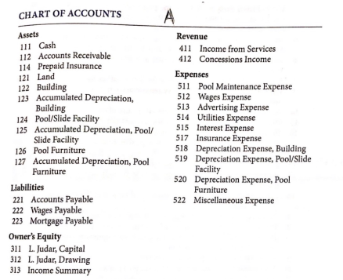
Unit 1 – Prepare journals required for posting general ledger
In accordance with double entry accounting principles
Steps in Preparation of Trial Balance:
Calculate the balances of each of the Ledger Accounts.
Record debit or credit balances in Trial Balance.
Calculate total of the debit column.
Calculate total of the credit column.
Check if debit is equal to credit.
Record the transactions in the journal.
Post them in the general ledger.
Then prepare a trial balance to verify that the debit totals equal to the credit totals.
The general ledger is used to prepare financial statements and contains a list of all the accounts, referred to as the chart of accounts that are active.
The ledger is impacted by normal business activity and can be documented by hand or electronic record.

Slide 6
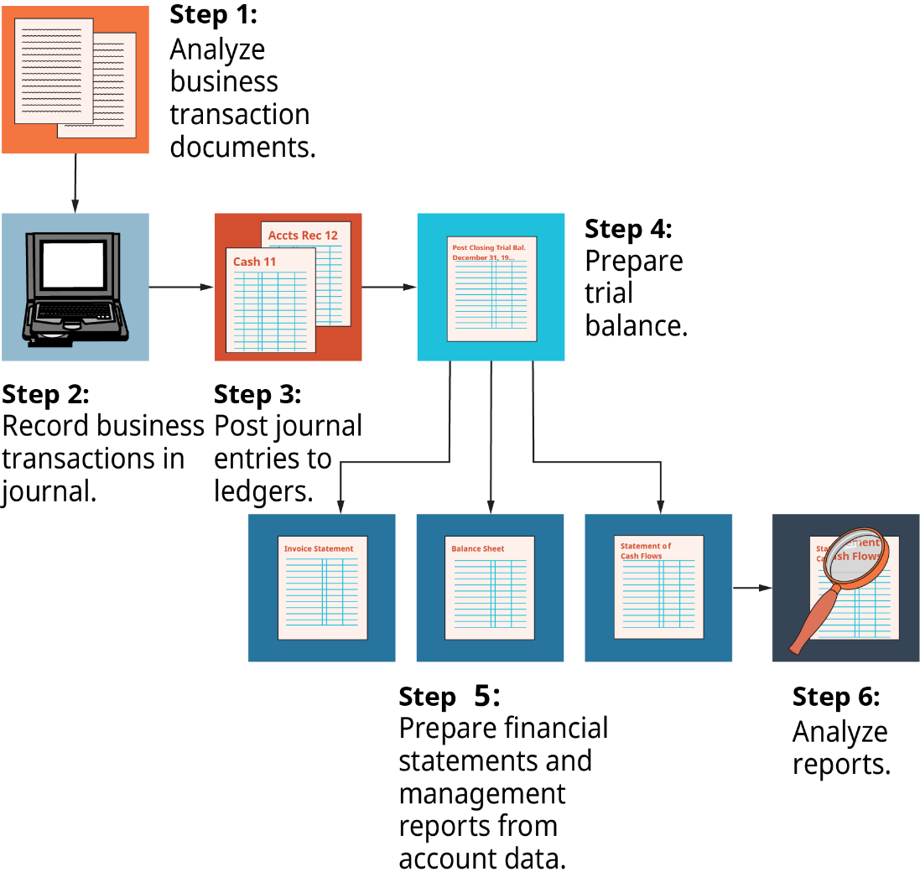
Unit 1 – Prepare journals required for posting general ledger
Ledger Accounts are like “Categories of income or expenses”.
Ledger Accounts make it easy to determine all Marketing costs, Wages costs, etc.

Slide 7
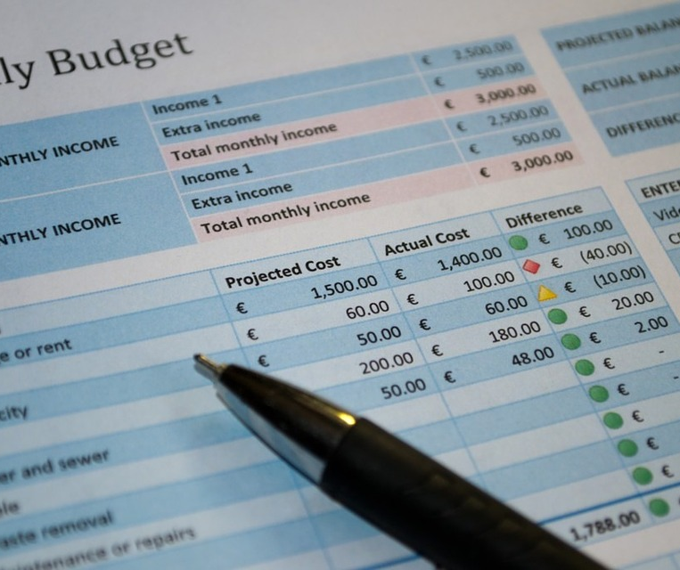
Unit 1 – Prepare journals required for posting general ledger
Examples of Bookkeeping Systems:
Xero Accounting
Quickbooks
MYOB
Here are the best free accounting software available:
Wave
ZipBooks
Pandle
GnuCash
CloudBooks
Zoho Invoice
NCH Express Accounts

Slide 8
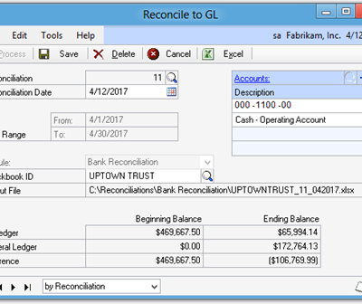
Unit 1 – Prepare journals required for posting general ledger
Why do you think you should reconcile your accounts?
When you reconcile your accounts, you are:
Checking that payment of your accounts has been processes through your bank account
Checking that all monies paid into your account have registered
Ensuring that all deposits and withdrawals from your bank account are correct.
Leads to more accurate financial statements​
Proves the balance is correct​
Proves the transactions that add up to the end balance are correct.*
This Photo by Unknown Author is licensed under CC BY-SA-NC

Slide 9
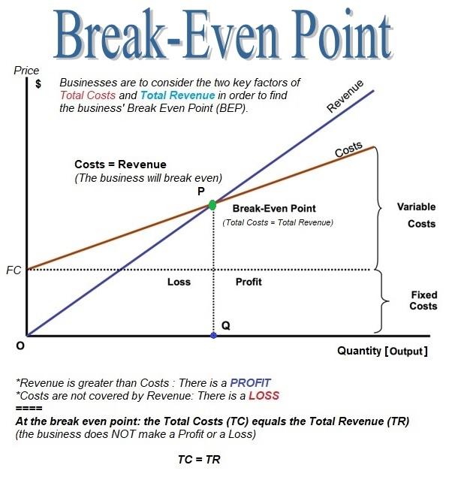

Unit 1 – Prepare journals required for posting general ledger
What is the breakeven point?
A Break-even point is the level at which sales equal the total of all costs, that is the point at which there is neither profit nor loss.
In other words, the break even point of a business is the point at which all variable and fixed costs are met, but no operating profit is achieved.​
QUESTION:
Can a business keep operating at a breakeven point?

Slide 10

Unit 1 – Prepare journals required for posting general ledger
Daily tasks (Entering sales and purchases, checking cash register, bank deposit of cash, checking online payments)
Weekly tasks (Checking accounts receivable, checking bills & payments due)
Fortnightly tasks (Payroll)
Monthly tasks (Checking financial performance of business against the projected performance) Plan for savings, investments and/or large bills ahead.
Quarterly tasks (BAS Statements, SEA Statements)
Yearly tasks (Stock take and Income Tax)
Recording your financials is not only important to check the financial health of your business it is also a legal requirement for tax purposes.
Make a calendar for yourself with specific dates to remind you when these things are due!
There are deadlines for the tax requirements you need to be aware of! As a business owner you are responsible for paying all taxes including income tax and GST.

Slide 11



– Make a list of the designated timelines and guidelines you would use for maintaining your daily financial records?
Let’s Discuss…
This will include details of lodging a Business Activity Statement (BAS) if you are planning to register for GST.
What is your timeline going to look like?
Imagine someone needs to take over your role, write instructions on what needs to be done and by what date.

Slide 12
Unit 1 – Prepare journals required for posting general ledger
Single entry bookkeeping
Double entry bookkeeping
In single-entry bookkeeping, you maintain a cash book in which you record your income and expenses. Start with your existing cash balance for a given period, then add the income you receive and subtract your expenses. After you factor in all these transactions, at the end of the given period, you calculate the cash balance you are left with.
A typical cash book will have the following information:
Date: The date on which the transaction takes place
Description: A brief note on the transaction
Transaction value: The value can be either incoming (debit) or outgoing (credit)
Balance: Running total of how much cash you have in hand
The double-entry system starts with a journal, followed by a ledger, a trial balance, and finally financial statements.
Journal: This is an accounting book where the transactions are recorded sequentially, in chronological order. It need not be balanced.
Ledger: This is a book of final entries where the transactions are divided and recorded in separate accounts. It must be balanced.
Trial balance: This is a bookkeeping worksheet that reflects the credit and debit balance of all ledger accounts. One of the important features of the trial balance is that it maintains the arithmetic accuracy of transactions.
Financial statements: These are a collection of summary-level reports that reflect the organisation’s financial results, position, and cash flow.

Slide 13
Unit 1 – Prepare journals required for posting general ledger
Single entry bookkeeping
Double entry bookkeeping
In single-entry bookkeeping advantages are:
Simple method: Easy to apply and understand.
Accounts are not separated: Generally, there is nothing more than income and expenses, which saves time. However, determining how much was spent on Marketing or Advertising is not easy and requires extra effort.
Practical only for Micro-Businesses: If you offer, several ways for customers to pay, single entry quickly becomes confusing and difficult to check.
The double-entry system has several advantages over the single-entry system:
Recording method: Single-entry bookkeeping gives a one-sided picture of transactions recorded in the cash register. In double entry, changes due to one transaction are reflected in at least two accounts. The double-entry system is preferred by investors, banks and buyers because it gives them a more complete financial picture of an organization.
Error detection: In double entry, debits and credits must always be the same. If that is not the case, then there is an error. This makes it easy to spot errors and ensure that they are not carried forward to other journals and financial statements. In single entry, there is no method for error correction or detection.
Company size: The single-entry system is only appropriate for small enterprises, whereas the double-entry system can be used by all sizes of businesses, including large ones.
Preparation of financial statements: The information recorded in a single-entry system isn’t adequate for financial reporting or preparing profit and loss statements. Bigger organizations rely on these reports to track their performance, so they need the extra information captured by double-entry accounting.

Slide 14
– Confirm if you will be using single or double entry bookkeeping and why you made your choice?
Let’s Discuss…
Single or Double entry bookkeeping
Why did you make that choice?

Slide 15

Unit 1 – Prepare journals required for posting general ledger
Cash accounting
Accrual accounting
Q4
Cash accounting records revenue when money is received and expenses when money is paid out.
Cash accounting:
is a simple system that keeps track of your business cash flow
suits smaller businesses if you mostly have cash transactions (for example, a hairdresser or grocery store)
gives you a picture of how much money you have in your till and your bank accounts.
However, it doesn't show money that is owed to you or money you owe to others.
Accrual accounting records revenue when it is earned and expenses when they are incurred.
Accrual accounting:
is more complicated than cash accounting
suits businesses that don't get paid straight away (for example, architects who provide a service then invoice for it later)
tracks your true financial position by showing money owed to you and money you owe others
is helpful if you deal with lots of contracts or large amounts of money.
Accrual accounting is more complicated than cash accounting so you'll need an in-depth understanding of bookkeeping methods or a professional to help you out.

Slide 16
– Will you be using cash or accrual accounting and why? How you would you follow up on outstanding accounts?
Let’s Discuss…
Cash or accrual accounting.
How you will follow up on outstanding accounts.
Imagine that someone needs to take over from you. Write a procedure or checklist, so they understand what they need to do.

Slide 17
– What is the purpose of the general ledger and conducting a trial balance?
Let’s Discuss…
Hint: a trail balance is completed in accordance with double entry accounting principles and not required for single entry accounting.
Purpose of general ledger?
Purpose of a trial balance?

Slide 18
– How are you going to manage your accounts and bookkeeping eg: manual, accounting system, accounting apps?
Let’s Discuss…
How will you manage your accounts receivable and accounts payable considering the various ATO record requirements below to confirm income and expenses?
Tax invoices
Bank statements
Merchant facility statements (EFTPOS)
Receipt books & cash receipts
EFTPOS receipts
Tap-and-go (contactless) payment
Smart phone & tablet card processing
Online payment receipts (Paypal etc. )
Cash register tapes
Records of cash sales
Reconciliation of daily sales sheets
Loan agreements
Method of presenting financial data
Procedures for checking errors

Slide 19
– What is cash flow and why is it important?
Q5
Let’s Discuss…
Cash flow (The money flowing in and out of your business)
Why is it important? (Cashflow is the lifeline of a business! If the business runs out of cash, it cannot continue to operate. Cashflow is high when money is coming in and spending is low, Cashflow is low when money is coming in but there are some big expenses. Negative cashflow means the business spent more money than it’s earning.)

Slide 20
– What is depreciation? How can it impact on a business?
Let’s Discuss…
Depreciation (The reduction in value of assets over time.)
How can it impact a business? (It can be deducted as a cost to the business however it also reduces the value of assets which can become a problem in case the business needs a bank loan.)

Slide 21




– What are debits and credits and how are they applied in the management of your accounts?
Let’s Discuss…
Debits & Credits (Debit = Money in (Plus), Credit = Money out (Minus))
How are they applied in accounting?
Whenever there is a Debit, there must be a Credit somewhere of that same amount.
In simple terms: The money must have come from somewhere or, in case of Credit, the money must have gone to somewhere.

Slide 22
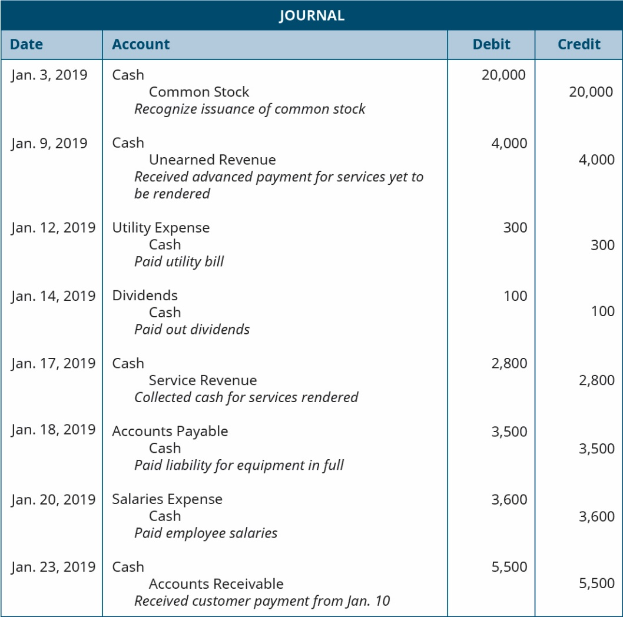
Unit 2 – Post journal entries and reconcile discrepancies
Reconciliation discrepancies are usually caused by the following factors:
duplicate transactions.
transaction was associated to a different bank account.
previously reconciled transactions were edited or deleted.
the opening balance or an account is incorrect.
This Photo by Unknown Author is licensed under CC BY-SA-NC

Slide 23
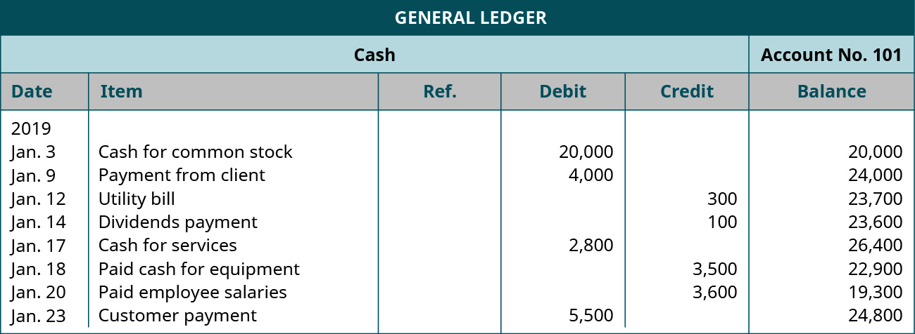
Unit 3 – Maintain general ledger
This Photo by Unknown Author is licensed under CC BY-SA-NC

Slide 24
To Do List
Complete and submit Topic 7 Quiz
Research your business requirements under Taxation Law (ATO)
Find suitable accounting software for your type of business
Find sources of specialist advise you can call upon regarding bookkeeping and accounting
Update your business plan

