Slide 1

Topic Five – BSBESB303
Organise Finances for
New Business Ventures

Slide 2
In this topic we will cover:
Prepare to organise finances for new business venture
Determine required finances for new business venture
Plan to access finances for new business venture

Slide 3

Unit 1 – Prepare to organise finances for new business venture
What are fixed and variable costs?
Fixed cost:
Fixed costs are those costs that do not vary with respect to changes in output and would accrue even if no output was produced. E.g. Rent, interest payments, property taxes and employee salaries.
However, fixed costs are restricted to specific time frame, since over the long run fixed costs can vary. For example, a manufacturer may decide to expand capacity in tandem to the increase in demand for its product, requiring a higher level of expenditure on plant and equipment. Fixed cost continue regardless of the sales.
Variable Cost:
Variable cost changes proportionately to the level of output. For manufacturers, the key variable cost is the cost of materials. Variable costs are dependent on sales.
Total Operating Cost:
It is defined as the sum of fixed, variable and semi variable costs.

Slide 4
Unit 1 – Prepare to organise finances for new business venture
Hourly rate price calculation:
If your desired personal income is $83,500 (before Tax), your business has $30,000 in overheads/costs, and you are looking to make $16,500 in profit you will need to generate $130,000 in revenue. With this total figure the following calculation can help you work out your hourly rate.
Desired profit amount + desired salary + operating costs / number of income producing hours = your hourly rate.
For example: Desired profit of $16,500 + desired personal salary of $83,500 + operating costs of $30,000/1040 income generating hours = $125 per hour.
One hour you spend on things other than income generation is either, costing you $125 per hour or, driving up the hourly rate you need to charge!
Note: Non-Income generating hours are; Holidays, Sick leave, Education time, Maintenance down time, etc.

Slide 5
Unit 1 – Prepare to organise finances for new business venture
Break-even Point calculation:
You need to know the break-even point of your business.
(Required personal salary + operating costs) = Total Revenue.
For example: (Required personal salary of $70,000 + operating costs of $30,000) = $100,000 break-even
New (Small)Businesses can’t survive for long at a break-even point, they need to make a profit to survive challenging times.
Note: Profit goes into the business cashflow, business savings, business investments etc. (aka Business Equity)

Slide 6

Unit 1 – Prepare to organise finances for new business venture
What are common methods of Pricing?
Market-based pricing: Attempting to match the market rate and still make enough profit to be viable.
Cost-based pricing: Adding an agreed percentage to the cost of the item and then marketing it to the customers at this fixed price.
Competitive pricing: Attempting to create price-based competition by pricing below main competitors.
Premium or luxury pricing: Pricing high to obtain prestige and maintaining marketing to meet these needs.
Hourly rate pricing: Usually for a service paid by the hour.

Slide 7
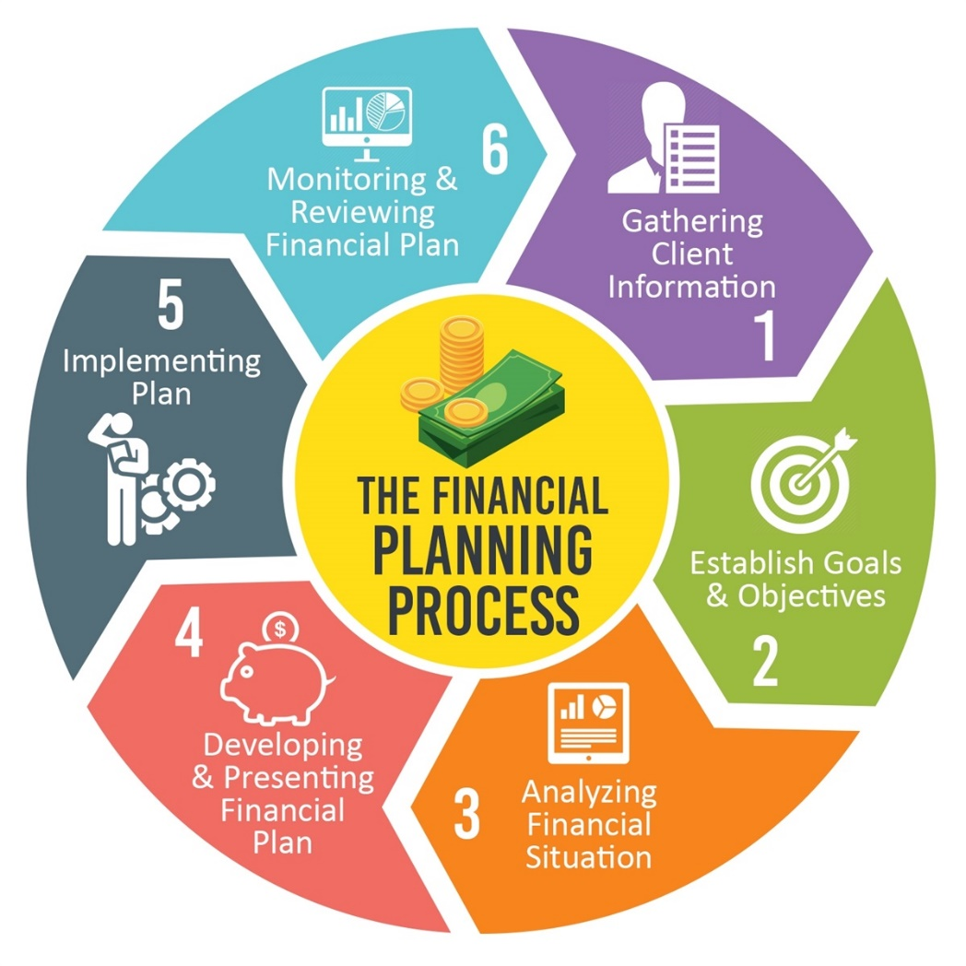
Unit 1 – Prepare to organise finances for new business venture
What finances do you need?
Gather information
Establish Goals & Objectives
Analyse financial situation
Develop & present financial plan
Implement financial plan
Monitor outcomes and review financial plan

Slide 8
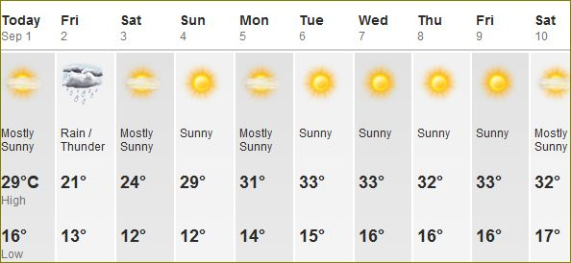

Unit 1 – Prepare to organise finances for new business venture
Financial Forecasting?
Gather information
Establish Goals & Objectives
Analyse financial situation
Make a prediction based on available information
Create a financial plan
Monitor outcomes and review financial plan
Note to self: Prepare to bring umbrella on Friday!

Slide 9



Business Plan & Financial Plan Activity – Describe the methods for costing or pricing and your preparation of financial forecast? Why is it important to distinguish between fixed and variable costs?.
Let’s Discuss…
What are the methods for costing?
What is a financial forecast?
Why is it important to distinguish between fixed and variable cost?

Slide 10

Unit 1 – Prepare to organise finances for new business venture
Financial Terminology?
GST – Goods and Services Tax
Liability – Money you owe
BAS – Business Activity State
PAYG – Pay as You Go
Assets – Things you own
Income Tax Return – Annually
Profit – (Revenue – Costs = Profit)
Depreciation – Decrease of value of assets over time

Slide 11
Income Tax Return
Assessable income | Exempt income | Taxable income
Assessable income is income that can be taxed, provided you earn enough to exceed your tax-free threshold. (Any income that goes into your account) Examples of assessable income are: salary and wages (contracting work payment) tips, gratuities and other payments for your services allowances for things like car, travel, clothing and laundry (Personal expenses) interest from bank accounts dividends and other income from investments bonuses and overtime an employee receives commission a salesperson receives pensions rent | Exempt income is income that cannot be taxed. Examples of exempt income include: some government pensions and payments, including the disability pension some education payments. If the only income you receive during a financial year is exempt income you do not have to pay any income tax on it. | Your taxable income is the income you must pay tax on. It is the term used for the amount left after you have deducted all the expenses you are allowed to claim from your assessable income. Assessable income − allowable deductions = taxable income The important thing to remember about deductions is that you apply them to reduce the amount of income you pay tax on, you do not deduct them directly from your tax amount.

Slide 12
Business Plan Activity – Explain the following key financial terminologies:
Let’s Discuss…
GST
Liability
BAS
PAYG
Asset
Income Tax Return
Profit
Depreciation

Slide 13


Marketing versus Finance
Q5
The relationship between marketing and finance is arguably one of the most important within any business. Traditionally perceived as an adversarial tug of war between marketing on one side spending the money and finance on the other trying to save it, this relationship has evolved into a modern marriage of equals.
Investing in Marketing can generate more revenue
Investing in Marketing increases expenses, and decreases profit
Financial profit is needed for the business to survive
Financial profit can go up if the revenue goes up
Marketing says: Campaign costing $20.000 could generate $150.000 in sales this year.
Finance calculates: Overhead cost $50.000+ Variable costs $30.000 + cost of marketing campaign $20.000 = $100.000 (expected profit from campaign = $50.000)
Marketing wants to reinvest the $50.000 profit in the next campaign. Good idea? Or Not?

Slide 14
Describe the relationship between finances (ie: income or revenue) and marketing strategies/business sales.
Let’s Discuss…
How do finances influence marketing and sales?
How do sales and marketing influence finances?
Hint: Marketing wants to spend money on campaigns to get more customers. Finance wants to keep money to increase profits.

Slide 15
Unit 2 – Determine required finances for new business venture
Assessing your financial situation.
Calculate your personal budget https://moneysmart.gov.au/budgeting/budget-planner
Calculate your pay, tax and superannuation https://paycalculator.com.au/classic/
Calculate business start-up costs https://business.gov.au/planning/new-businesses/calculate-the-start-up-costs-of-your-business
Calculate break-even point https://www.zoho.com/au/inventory/break-even-point-calculator/
Calculate your hourly rate (for services) https://www.smallbusiness.wa.gov.au/blog/how-calculate-your-hourly-rate

Slide 16
Unit 2 – Determine required finances for new business venture
What accounting software is there?
Here are the best free* accounting software available:
Wave
ZipBooks
Akaunting
GnuCash
CloudBooks
Zoho Invoice
Pandle
Most used by businesses and accountants:
Xero
Quick books
MYOB
Freelancer Accounting/Invoicing Software:
Rounded
Hnry | Tax for Self-employed Australians
Q4
* Free = Freemium or Free trials (read terms and conditions!)

Slide 17
Business Plan Activity – What accounting software or system are you planning to use, to manage your business and accounts?
Let’s Discuss…
Accounting Software
Accounting Systems

Slide 18
Unit 3 – Plan to access finances for new business venture
Where and how to get the finance you need it:
Avoid finance if you can! Bootstrapping (Using your savings) will pay off!
Crowd Funding is testing the market while raising funds
Low interest or no interest loans (NILS)
Bank loans / Redraw on Mortgage
ZIP pay or Credit Card (For small amounts you can pay over-time)
Angel Investors – Invest $5.000 - $10.000 into your business but want a percentage share of your business. They do not help you run the business. (Company Pty Ltd structure is required.)

Slide 19
Unit 3 – Plan to access finances for new business venture
GST – Registration
You will need to register for GST within 21 days if your turnover reaches $75.000 in the financial year.
If you are not registered for GST, you cannot put a GST amount on your invoice and you cannot claim GST amounts back on items purchased for the business.
If you're registered for GST, your invoices should be called 'tax invoice'. If you're not registered for GST, your invoices should not include the words 'tax invoice' – you must issue standard invoices.
Most basic foods, some education courses and some medical, health and care products and services are GST-free, often referred to as exempt from GST. Things that are GST-free include: most basic food. some education courses, course materials and related excursions or field trips.
Invoices always need to list the business contact details, terms and conditions of payment and an ABN or ACN.

Slide 20
What are the requirements for businesses that register for GST? What is the difference between and Invoice and a Tax Invoice and when will they apply?
Let’s Discuss…
When do you need to register for GST?
Does everything attract GST?
When do you issue an Invoice?
When do you issue a Tax Invoice?
What else needs to be on an Invoice?

Slide 21
To Do List
Work on Business Plan and Financial Template. (Save them to your computer so that you can work on them progressively and once they’re finished you can just submit them on Canvas.)
Complete and submit Topic 5 Quiz

