Slide 1

Topic Three – BSBESB305
Address Compliance Requirements for New Business Ventures

Slide 2
In this topic we will cover:
Research compliance requirements for new business ventures
Seek specialist advice on compliance and risk minimisation
Take action to support business compliance

Slide 3


Sole Trader
Q8
Advantages
Disadvantages
Easy & low costs to set up
All profits go to the owner
Minimum legal requirements
No separate tax return required
No registration required if trading under own name
Having direct control and authority over the business
Wind up process is simple
Personal liability for all debts
Pressure of taking on all the expendabilities
Ownership cannot be transferred to anyone else
If you are sick, there is no-one else to run your business
More difficult to raise finance
May have to pay provisional tax

Slide 4

Partnership
Q8
Advantages
Disadvantages
It widens the scope and skills within the business. (One partner may be good at sales and administration, the other at technical and practical applications.)
As a partnership the tax responsibility can be shared. E.g.: Tax on gross income after expenses divided 50/50 or 30/70 or whatever the accountant feels is most advantageous.
Having a partner means that you are able to share the burden of responsibility and decision making. Two heads are better than one!
Simple and low cost to form an operate.
Limited outside regulation
Decisions are shared and have to be mutually agreed to.
If one partner wants out there is no partnership agreement setting out mutually agreed guidelines, then trouble can occur.
If there are disagreements it could cause delay or obstruction within the business.
The big risk of course is that if the business fails the creditors will pursue the partners and if one partner has no assets to recover the other partner is fully liable.
Each partner is liable for the acts of the other partners.

Slide 5

Pty Ltd. Company
Q8
Advantages
Disadvantages
Shareholders are not liable for financial commitments of the company
Shares in a public company can be easily bought and sold
Only one person is required to constitute a public company
Start up capital can generally be easily obtained
Directors are elected on the vote of the shareholders and selected on expertise
Separate tax returns for company and individuals
One of the most expensive structures to set up.
Extra reporting requirements
Less privacy
Compliance with government regulations monitored
Memorandum of understanding & articles of associations may place limitations
Founder can be voted out of the CEO role

Slide 6

(Family) Trust
Q8
Advantages
Disadvantages
Liability is limited to the Trust
Taxation benefits
Not open to scrutiny
Not dissolvent on death, retirement or bankruptcy of a family member
Most expensive to set up
Life of the trust is restricted by the trust deed
Trust deed governs the Trust operations
Can be more difficult to raise capital

Slide 7



Business Plan Activity – What legal structure are you considering for your business profile inline with planned goals and objectives and why have you chosen this option?
.
Let’s Discuss…
What are legal structures of business?
What are cost and benefits of each for business?
Which one do you choose?
Why did you choose that legal structure?

Slide 8
Unit 1 – Research compliance requirements for new business ventures
National, State and Local Government Laws
Before starting a business, the following basics need to be considered:
Legal Regulations: What laws, regulations and licenses need to be considered (International, National, State and Local Government Law)
Taxation: % to be paid, GST registration, BAS statements and annual taxation
Insurance requirements: ( Self-Employment Assistance Program requirement is $5 million Public Liability cover) Will you need any other insurance?

Slide 9
Unit 1 – Research compliance requirements for new business ventures
Business Registration Requirements
Q1
https://asic.gov.au/for-business/registering-a-business-name/
https://www.abr.gov.au/business-super-funds-charities/applying-abn
https://ablis.business.gov.au/search/activity
https://www.wa.gov.au/service/business-support/business-registration-and-licensing
https://www.ato.gov.au/business/starting-your-own-business/in-detail/tax-basics-for-small-business-video-series/
https://www.commerce.wa.gov.au/worksafe/licences-registrations-and-notices
Business Name Registration
ABN or Australian Business number
GST or Goods and Services Tax
TFN or a Tax file number
OHS responsibilities and procedures
Superannuation
PAYG or Pay as you go withholding
Q2

Slide 10
Business Plan Activity – Research your Business Name availability. Even if you have used the name before!
Let’s Discuss…
Just registering a business name does not mean you automatically own the right to the name! If you want to own the business name; it must be registered as a Trademark. If someone else already owns the Trademark, you cannot use the name without their permission.
Q3
Will you register your Business Name as a Trademark?
What happens if someone else registers your business name as a Trademark?

Slide 11
Business Plan Activity – Identify and list the registration, taxation, legislative and regulatory requirements for your business? Include a consideration of OHS responsibilities and procedures.
.
Let’s Discuss…
What are registration requirements business for business?
What are taxation requirements for business?
What are regulatory requirements for business?
What are OHS responsibilities?
What could be an OHS procedure?

Slide 12
Business Plan Activity – List the licenses and permits you require for your business.
.
Let’s Discuss…
What are licenses for your business?
What are permits for your business?
https://ablis.business.gov.au/search/activity
Business Licence Finder - Home (smallbusiness.wa.gov.au)

Slide 13
Unit 2 – Seek specialist advice on compliance and risk minimisation
Different risks require different specialist advice. People who deal with risk all the time are insurance companies! They have made a science of assessing risks and how to reduce the risk of something bad happening.
Insurance policies (the fine print), will tell you what is covered and what is not covered under your policy. You will need to put your own policies and procedures in place, to reduce risks that are not covered by the insurance.
Industry bodies and organisations will in some cases have industry standards, codes of practice, etc. These are things everyone in a particular industry should adhere to.
Worksafe Australia, is a government organisation that helps employers make workplaces safer. Even if you are self-employed and a Sole Trader working by yourself, you still require to adhere to the WHS / OHS laws.

Slide 14
Business Plan Activity – What are the insurance requirements for your business? Who are suitable providers and what is the cost?
Let’s Discuss…
What are insurance requirements for your business?
What are who are suitable insurance providers for your business?
What do these insurances cost? (Per month or year? Ask for at least 3 quotes).

Slide 15
Business Plan Activity – Identify business/financial advisors and other sources of assistance relevant to compliance requirements and your business type. List below your sources of advice and specialist services that you have identified.
Let’s Discuss…
Who can be your business and/or financial advisors?
Where can you find other sources of assistance relevant to the compliance requirements and your business type?
Notes:
Business Mentors/Coaches from ABS & Small Business Development Corporation. Work Safe advisors. Certified Accountants. Lawyers specialised in business areas (contract law, consumer law, IP law etc.). Department of Foreign Affairs and Trade for international trade and shipping. Bankers, for loans, transactions and overseas transactions (Anti-money laundering laws.) Advertising / Marketing specialists, aware of advertising restrictions in the consumer law. Local council trade regulations.

Slide 16
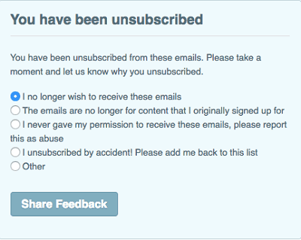
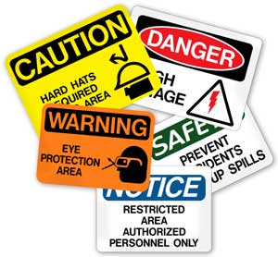
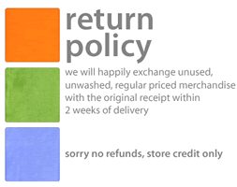
Unit 3 – Take action to support business compliance
List the steps you need to take to comply with all the requirements:

Slide 17
Business Plan Activity – One of the common WHS compliance requirements is maintaining a Risk Register.
A Risk Register should contain:
ID-number of the risk reported
The risk-rating Low-Medium-High
The probability or likelihood of the risk occurring
Photographic or Video evidence of the hazard (where possible).
Date, time and location of the hazard
Actions suggested to reduce the hazard

Slide 18
Business Plan Activity – Please consider the ongoing compliance requirements for your business in the following areas and note how you will aim to manage them were applicable?
Let’s Discuss…The following requirements
Following taxation and industrial relations principles
Updating and maintaining legal documents
Investigating areas of non-compliance
Monitoring provision of products/services
Taking corrective action where necessary

Slide 19
To Do List
Research the business structure (type of business) is best for your business idea.
Research the (International, Federal, State and Local) laws your type of business needs to comply with.
Write policies and procedures for your business compliance.
Update your Business Plan. (Save to your computer so that you can work on it progressively and once finished you can submit it via Canvas at the end of the course.)
Complete Topic 3 Quiz

