Slide 1

Topic Two – BSBESB302
Develop and Present
Business Proposals

Slide 2
In this topic we will cover:
Evaluate business ideas
Manage risks associated with business proposal
Develop proposal for viable business idea
Present business proposal

Slide 3

Unit 1 – Evaluate business idea
Would this type of business work for you?
You have identified a business idea.
Would this idea work for you?
Ask yourself the following questions:
What is important to me personally?
Can I fit the business in my current and future life-style?
Has the business the potential to generate the income I want or need?
Am I willing and able to put in the hours of work required?
Do I have all the knowledge, skills and/or assistance required?
Do I have support of my significant other(s)?

Slide 4


What are the key factors that will influence the viability of your business idea: financial returns, market demand, available clients, unmet market needs etc.
Internal factors:
o start-up costs
o increase in expenses
o limited cash flow
o meeting customer demand
o maintaining stock
External factors:
o rise in supplier costs
o economic conditions, such as a credit crunch or COVID-19
o changes in interest rates
o more efficient competitors
o social changes, such as changes in legislation or environmental issues.
Q1

Slide 5
Financial Viability of a Business
Financial viability is a business’s ability to generate sufficient revenue to meet the operating costs and make a profit.
Therefore, a business idea must be viable in the sense that it can create income which is more than the costs involved to implement it.
Question: Can you think of other types of viability?
Q2
Notes:
Viability time-wise or the time-cost ratio needs to be assessed also! (For example: if an item takes you an hour to make, and you can only work 8 hours a day, the maximum you can produce per day is 8 items. There is a maximum you can charge for such an item, let’s say roughly $40.00. The cost price of materials is $10.00 and your overhead costs (fixed cost) per hour are $10.00. That leaves you with $20 or roughly $18.00 after tax. That makes $144 profit per day. You want to save 20% as profit. That leaves you with $115.20 per day, times 5 days per week is $576 per week. If you’re spending $400 on rent per week, $150 on groceries and $50 on utilities and extras, you don’t have enough to make ends meet. ) Viability in relation to resources at the location. For example: Trying to grow rice in the desert where there is little to no water for miles, is not a viable option.

Slide 6
Opportunities within a Business
A great entrepreneur can see opportunities in almost everything, even when others cannot see it. They like to stay informed and talk to people. They ask what potential clients want or need. By doing so they get new information they can combine with other information.
They also assess their own wants and needs.
Example: When Richard Branson opened a club in London, it was common to have a dress-code for these type of clubs. However, people who wanted to go out and meet friends after work, did not want to go home to get changed! Richard Branson abandoned the dress-code and, although it was not "the-done-thing", his club became immensely popular.
Q6

Slide 7
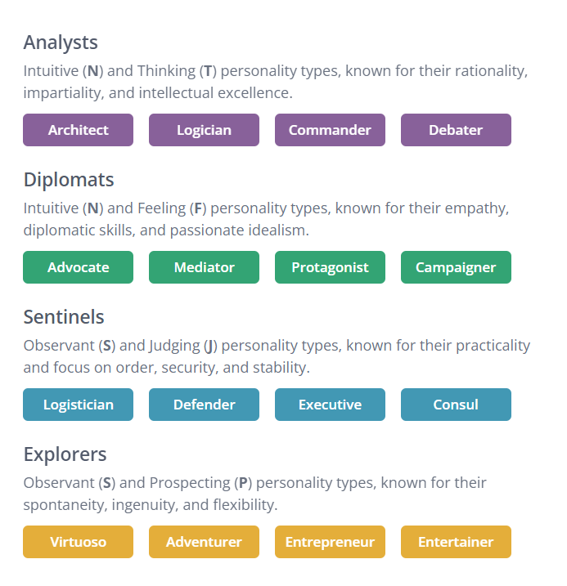
Unit 1 – Evaluate business idea
What personality type are you?
Quote by Socrates: “To know thyself is the beginning of wisdom.”
Understanding your strengths and weaknesses, will help you better manage your business. Complete a personality test to see what kind of person you are and assess your strengths and weaknesses.
https://www.16personalities.com/free-personality-test
When doing the test don’t overthink the answer, there are no right or wrong answers, it is just how you would feel or respond. Be uniquely YOU!

Slide 8


Business Plan Activity – What personal skills and attributes do you have that will assist in supporting the success of your proposed business idea? Are there any gaps in skills or knowledge that need to be considered?
Let’s Discuss…
How does your personality help your business?
What are great business attributes?
How could your personality harm your business?
What are (other) skills you need to succeed?

Slide 9
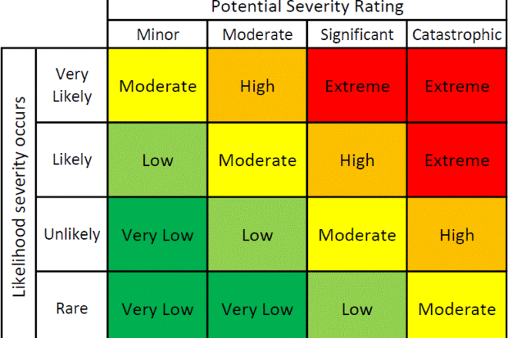
Unit 2 – Manage risks associated with business proposal
It will be necessary to assess all perceived risks to determine their impacts on the viability of your business.
Identifying risks can help you properly manage them - you can begin with these questions:
Identify the Risk - What can go wrong?
Rate the Risk - How major or minor is the risk?
Likelihood of Risk – What is the likelihood the risk?
Minimize the Risk - What can I do to prevent it?
Manage the Risk - What do I do if it happens?
Risks can be assessed by completing:
A Risk Assessment Matrix
SWOT analysis
A PEST analysis

Slide 10

Unit 2 – Manage risks associated with business proposal
Q5
It will be necessary to assess all perceived risks to determine their impacts on the viability of your business.
Identifying your strengths, weaknesses, opportunities and threats, will help you determine other potential risks or threats to your business you may not have considered before.
You will need to look at:
Strengths
Weaknesses
Opportunities
Threats
Now that you have identified some of these categories:
Focus on the weaknesses and threats.
How can you reduce these?

Slide 11

Unit 2 – Manage risks associated with business proposal
Q5
It will be necessary to assess all perceived risks to determine their impacts on the viability of your business.
You will need to identify political, economical, social and technological threats to your business.
You will need to look at:
Political climate (decisions politicians make, that could affect your business)
Economy
Social changes
Technological changes
Now that you have identified some of these categories:
Focus on the potential threats.
How can you be prepared for these potential threats?
Identify the risk
Assess the likelihood of the risk occurring
Assess the severity of the risk
Prioritise the risks by levels
Eliminate the risks where possible
Reduce the risks if elimination is not possible

Slide 12
Business Plan Activity - What are the business risks relevant to the opportunity you are considering?
Let’s Discuss…
Outline the principles of risk assessment.
You need to consider and assess what has happened in the industry in the past as well as current impacts and what can be expected in the future.

Slide 13
Request for Proposal
What is a Request for Proposal?
Companies that are looking for specific products or services will go to the market and look for individuals or companies that could supply their demand. They will ask for a Request for Proposal, it is slightly different to a Request for Quote.
A Request For Quote (RFQ) works best when the customer already knows which product or service you want and is just looking for the best price
Request For Proposal (RFP) allows the customer to choose the most qualified vendor and evaluate different solutions and approaches
Request For Tender (RFT) Tenders are more rigid and complex than RFPs. The tender is an “offer” that the bidders already accept in submitting a bid, resulting in a bid contract. The bid contract requires that the project owner and the successful bidder must enter into a contract to perform the project.
An RFQ focuses on price, while an RFP focuses on qualifications, proposed solutions, and price. RFT results in a binding contract if the bid is successful.
Q3
Notes:
If an RFP process is improperly designed and a court later concludes it was actually a tender process, the project owner can be subject to a claim of lost profits by an unsuccessful proponent. An RFP process has to be carefully drafted and developed to ensure that the “Request for Proposals” is not later considered by a court to be a tender.

Slide 14
Creating a Business Presentation
When creating a business presentation, you first need to establish:
Who is the presentation for? (A customer, Investor, Bank?)
Do you know your audience personally? (Formal or Informal language?)
Where and when do you need to present it? (Has the venue equipment available? Can you get there on time? Do you have preparation time?)
Who will be attending the presentation? (Can you give them information that applies to them specifically? Can you use language and terminology they will understand?)

Slide 15

Unit 3 – Develop proposal for viable business
Classroom Activity: Create a short 1-minute presentation (Pitch)
Pretend you are meeting with either potential customers or potential investors. You have been given 1 minute to speak. Create a short script to convince them you have an interesting investment opportunity, product or service!
Business Presentation to Investors – Explaining to potential investors why they should invest in your business and what they will get in return.
Business Presentation to Clients/Customers – Explaining to your potential customers what you do as a business. Why you are unique and why they really need to talk more with you!

Slide 16
Unit 4 – Present Business Proposal
Classroom Activity: Present a short 1-minute presentation (Pitch)
You have 1 minute to speak. Convince your audience you have an interesting opportunity, product or service!
Ask for feedback!
What did you do well?
Where can you improve?
What else was good about the presentation?
4-3 sentences max.
What do you do offer?
What’s your Unique Selling Point? (USP)
What do you want people to do? (CTA)

Slide 17
To Do List
Enter what you have learned in the Business Plan. Don’t forget to save to your computer so that you can work on it progressively and once the Business Plan is finished, you can just submit it on Canvas under Assignments - > Business Plan, Financial Plan, Marketing Plan, Completion Guide.)
Complete and submit Topic 1 Quiz
Complete and submit Topic 2 Quiz

